Slide 1




All You Need Is To Know How
Name | ID
Nour Muhammed | 20200605
Beshoy Ashraf | 20200118
John Fady | 20200133
Mohamed Samy | 20200446
Under Supervision:
Dr. Shaima M. Galal Dr.Sabah El sayed
Eng. Lamia Atef Eng. Ibrahim Ali
Notes:
طبعا احنا عرفنا اهمية التعليم عن بعد من بعد الكورونا وقد ايه احنا عندنا مشكلة كبيرة فيه

Slide 2


TABLE OF CONTENTS
01
Problem Statement
04
Project Specifications
02
05
Project Idea
Conclusion
03
Project Objectives

Slide 3

PROBLEM
STATEMENT

Slide 4
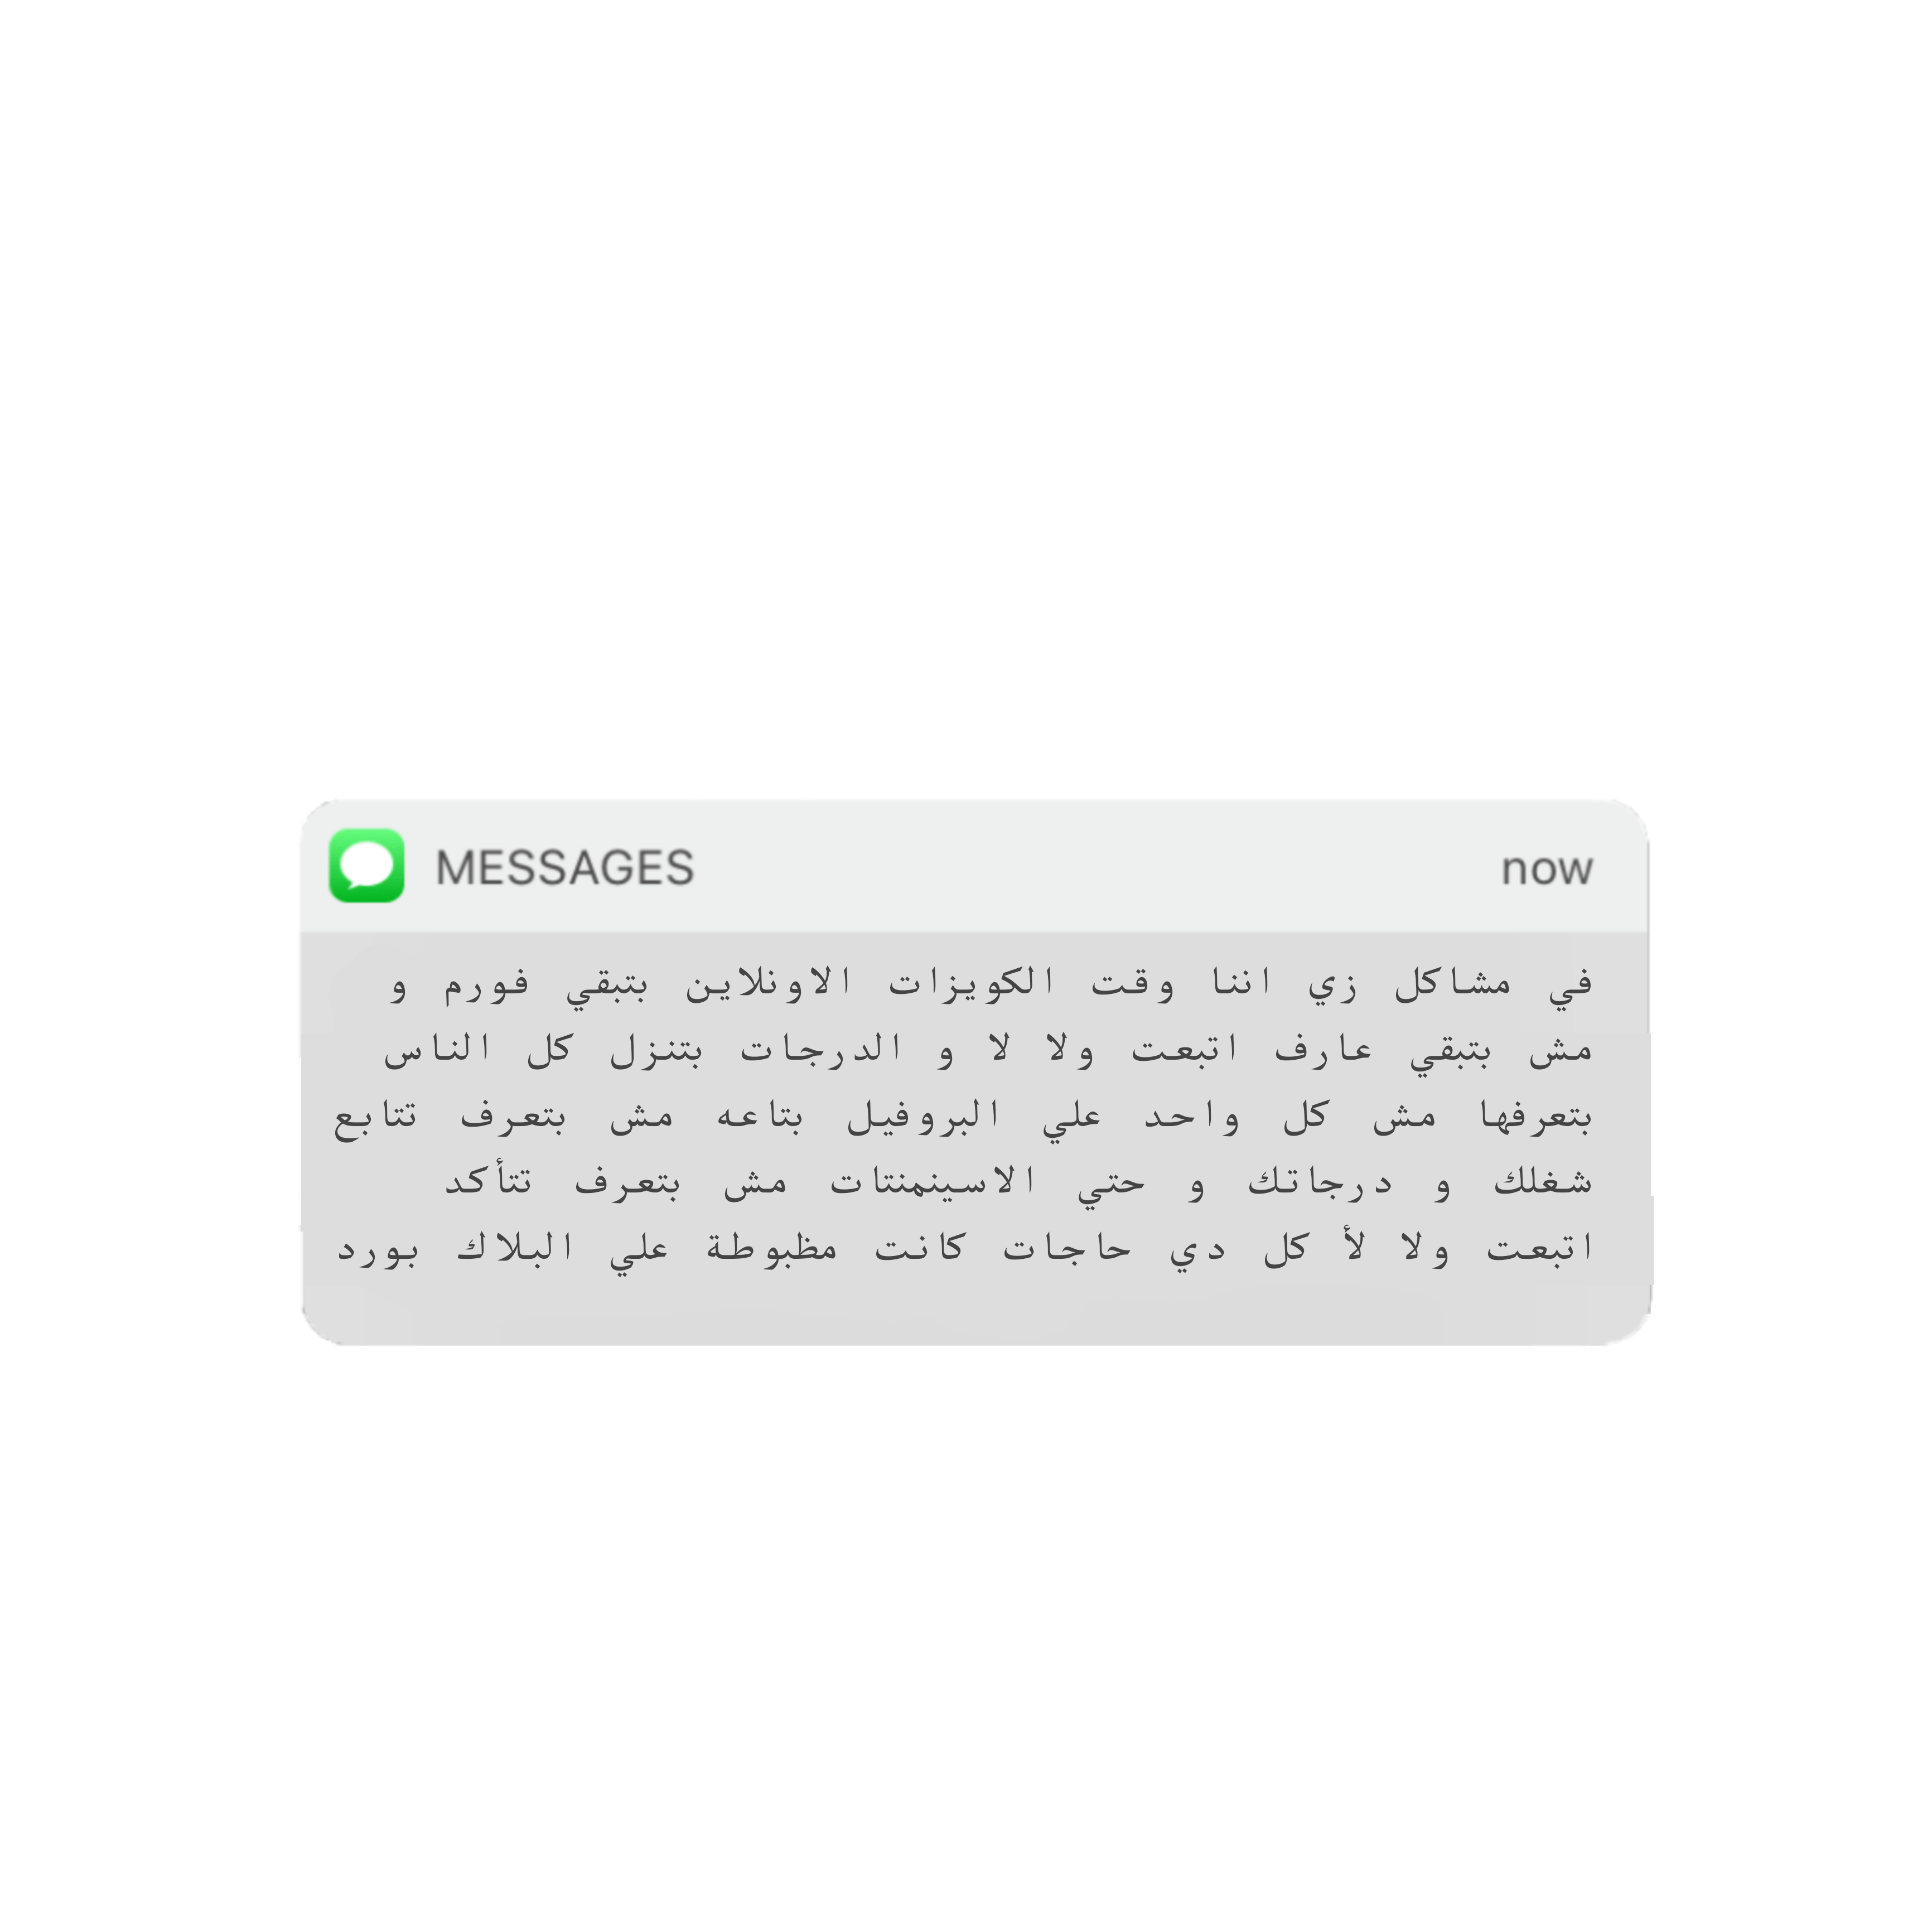
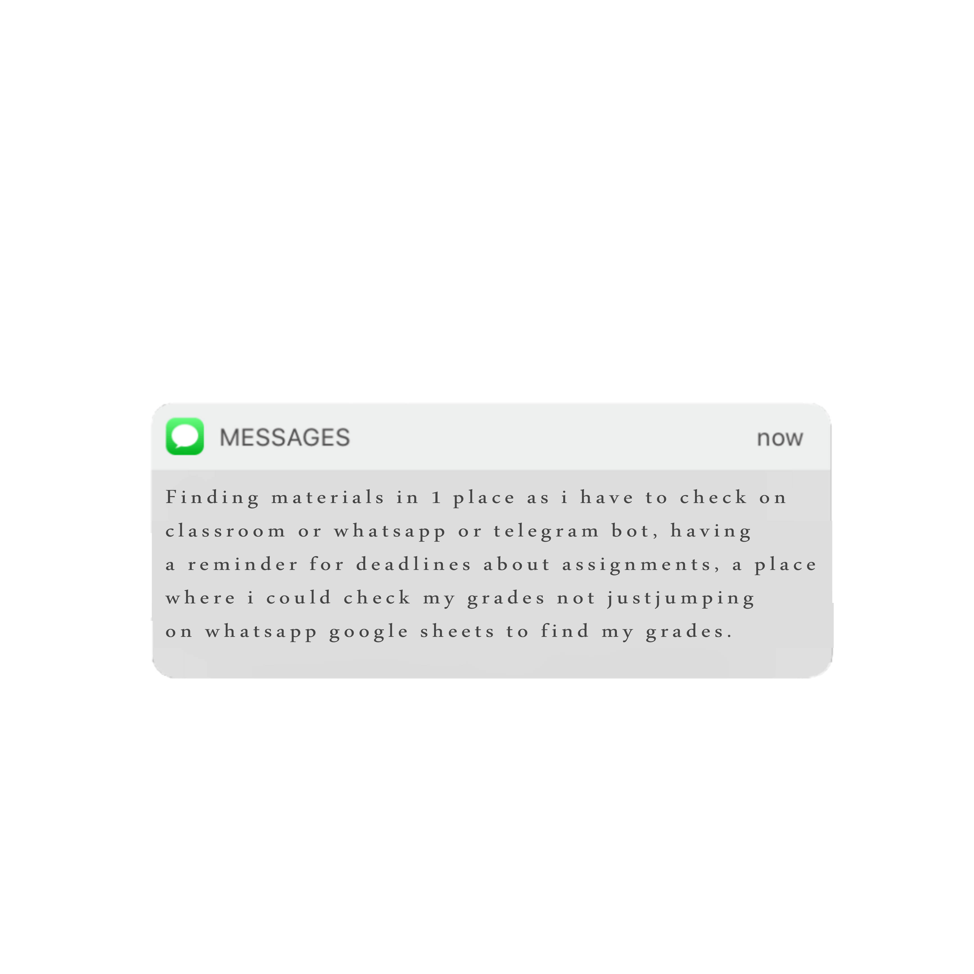
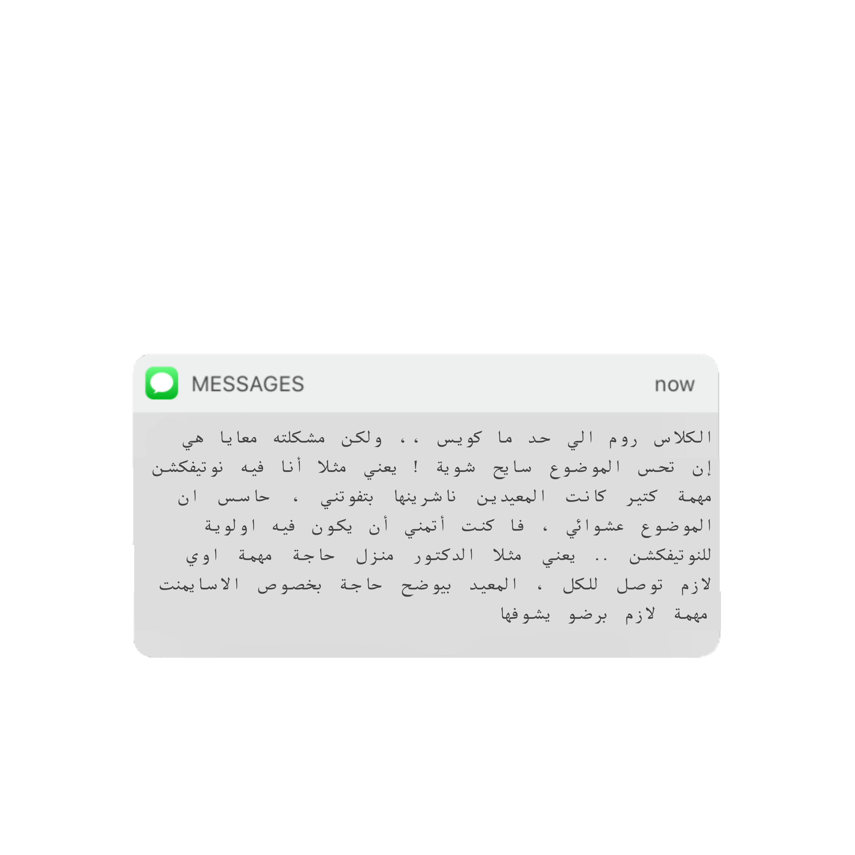
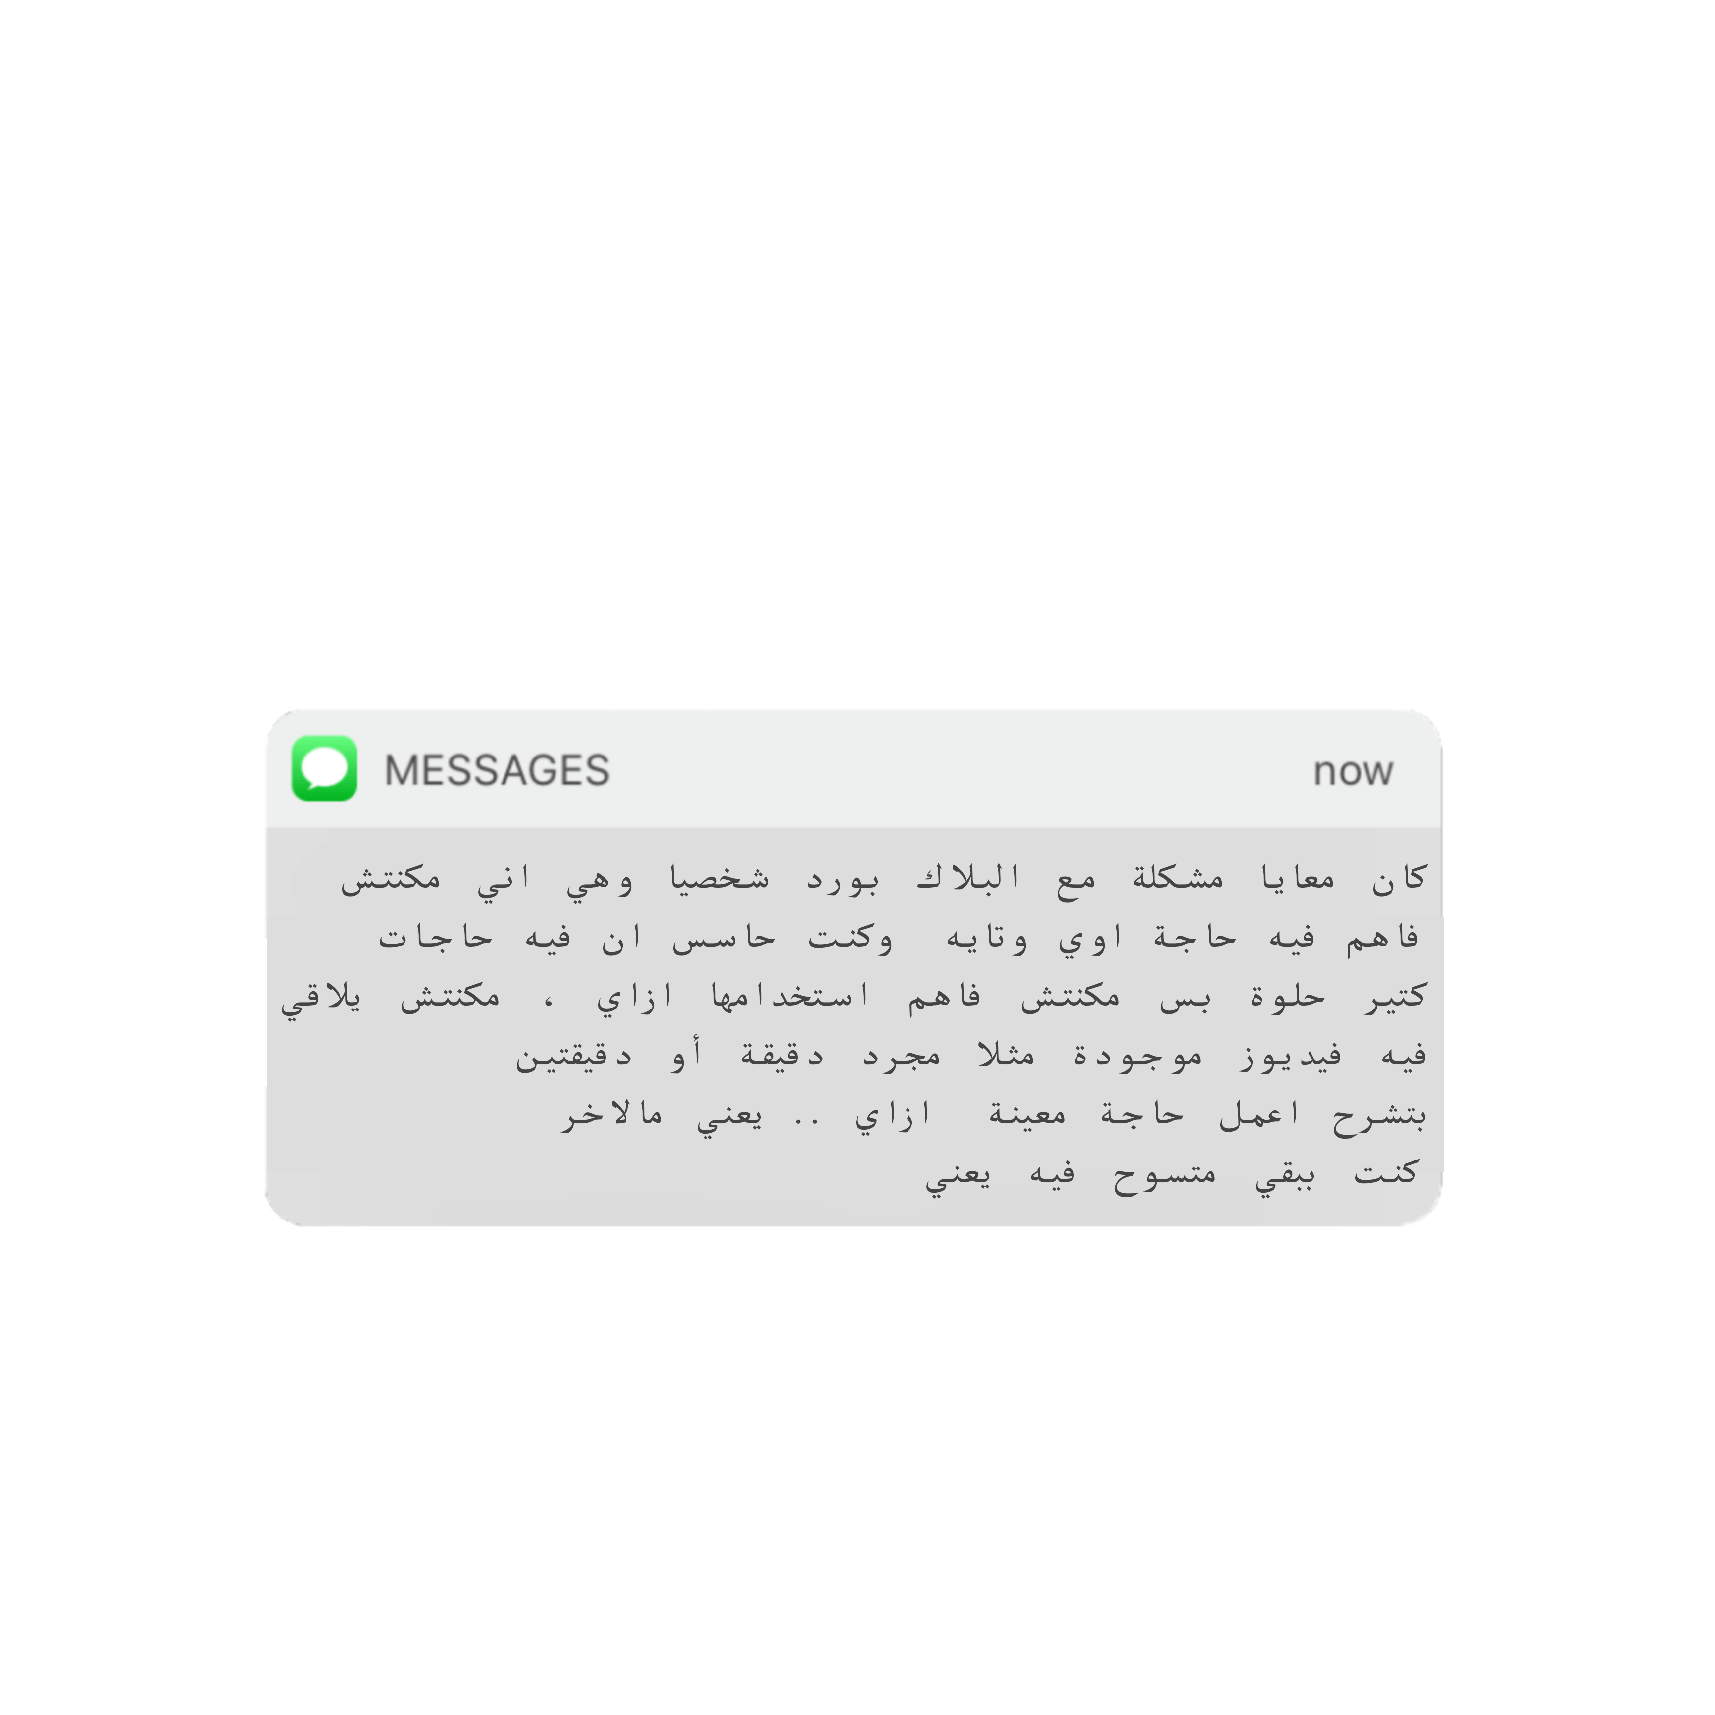
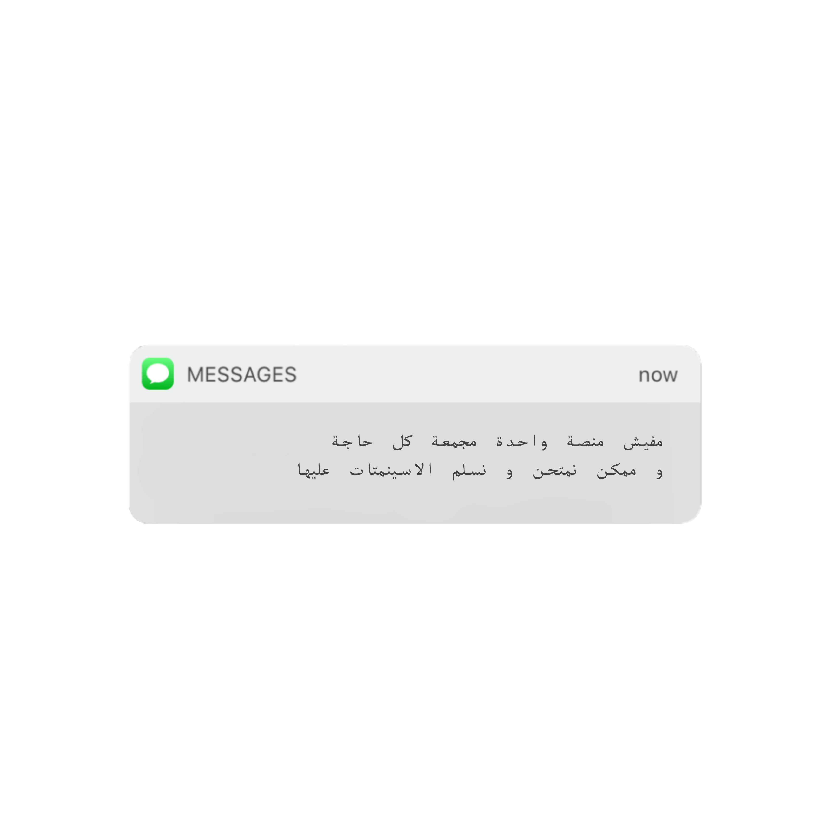
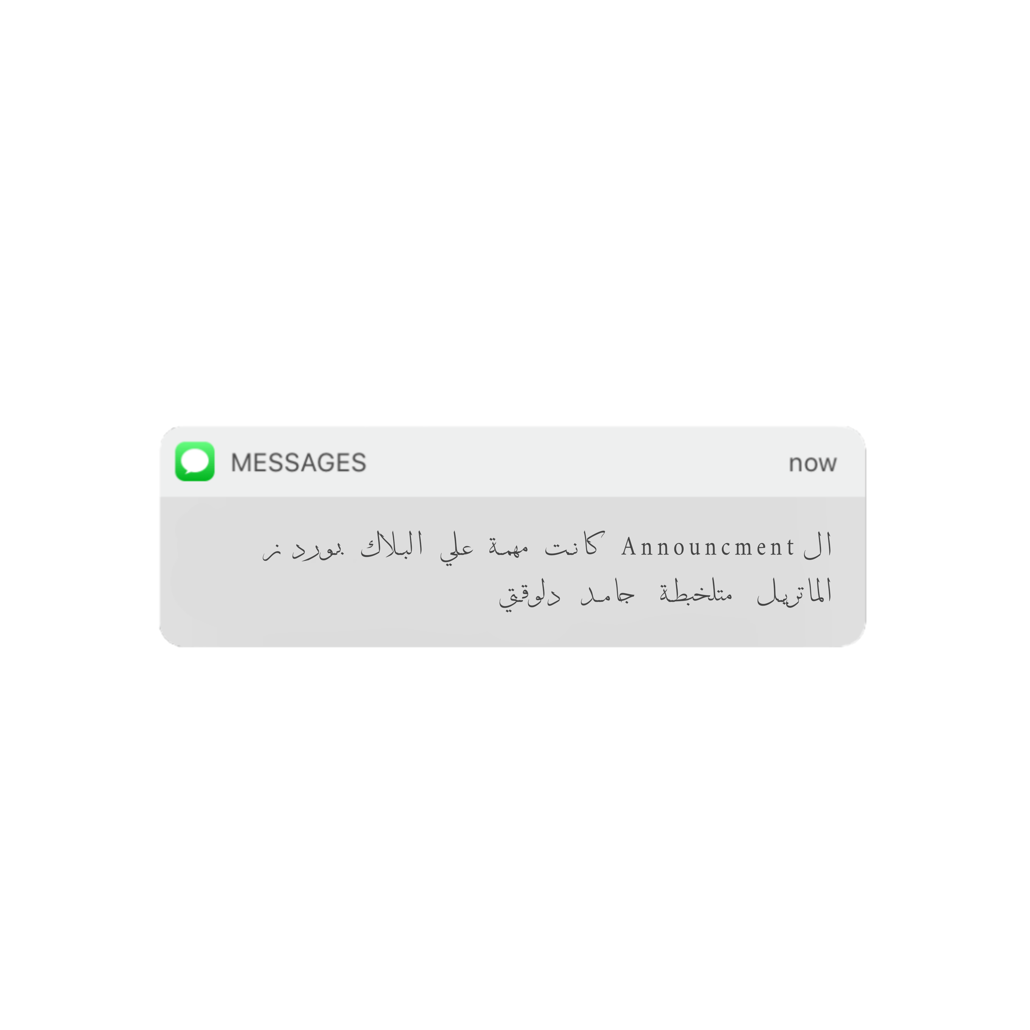
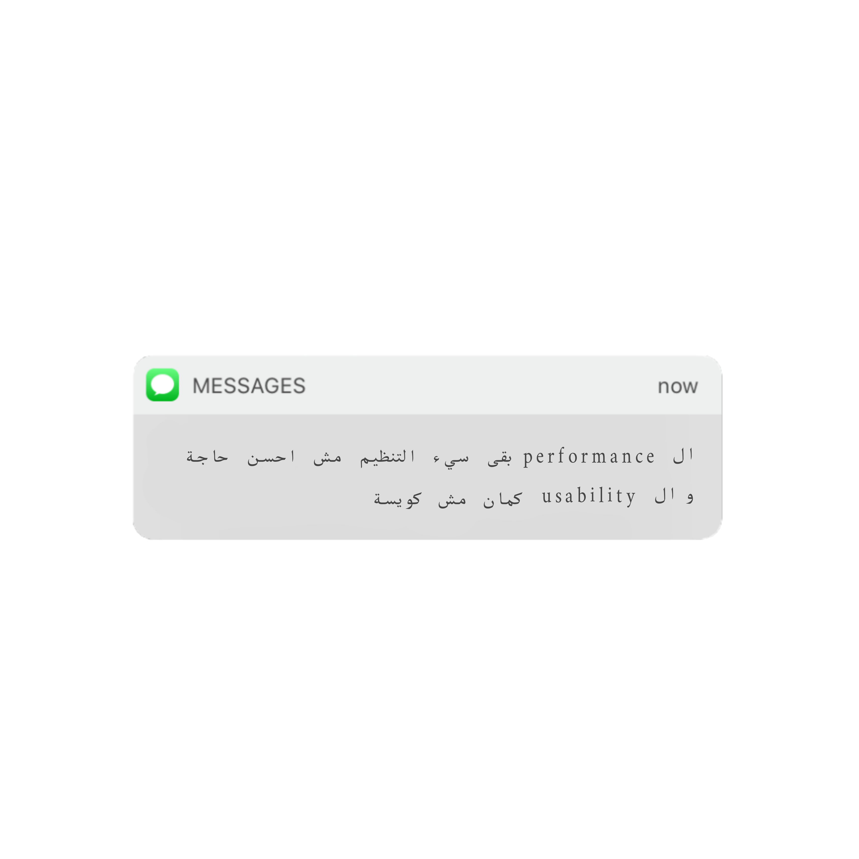

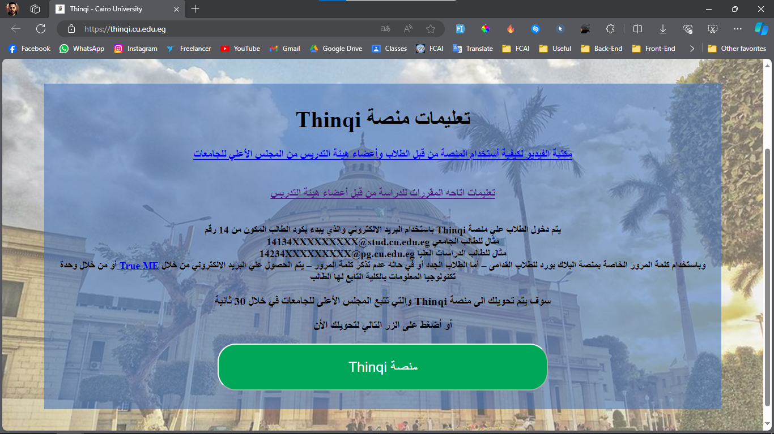
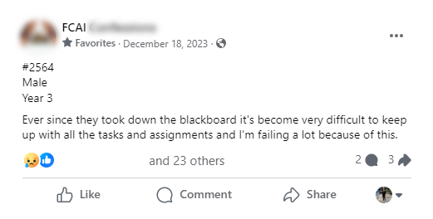

How is it started ?
Remember ?

Slide 5

Problem Statement
We are trying to solve the Learning Distraction process that can Cause :
  Inefficient.
  Time-consuming
  Limited access to information about available Content.
  Failing
Which leads to dissatisfaction.
Notes:
According to the American Psychological Association (APA), 80% to 95% percent of college students procrastinate.
Another study found that nearly 80% of students exhibit varying degrees of procrastination, with reasons including poor time management, lack of planning, laziness, and stress

Slide 6

PROJECT
IDEA

Slide 7

Project Idea
Introduction
No Need For Learning Distractions:
  Comprehensive Administrative Tools
  Efficient Content Management
  Interactive Learning Environment
  Smart Learning Techniques
Notes:
فكرة مشروعنا هي اننا هنقضي على التشتت عن طريق اننا هناخد الحلو من كل المنصات الموجودة ونعيد صياغته باسلوبنا كطلبة قبل مانكون مبرمجين

Slide 8

Project Idea
MISSION
VISION
VALUES
Create a E-Learning Platform that simplifies Learning and Teaching processes
Make our Platform the best platform for Education Worldwide.
Develop a user-friendly platform to provide direct communication between the Educator and the Learner.

Slide 9

PROJECT OBJECTIVES

Slide 10

KNOWNOWOBJECTIVES
Ensuring that what we learnt helped us create a strong platform capable of competing with international platforms.
Our platform will increase the number of High Grades and increase overall satisfaction with the Learning process.
Providing a user-friendly and efficient platform for both Learner and Educator.
Providing direct communication between Learner and Educator.
Notes:
من اهم اهدافنا اننا نوظف اللي اتعلمناه من دكاترتنا في الكلية علشان نخلق منصة تنافس في السوق العالمي

Slide 11





SIMILAR WEBSITES
Website/Feature | Discussion Forum | (Offline) Exam Generation | Calendar | Live Streaming

Slide 12
STATISTICS
98.73M
40.4%
Monthly visits
Last Month Change
58.09M
37.72%
Monthly visits
Last Month Change
Notes:
اختارنا اننا نجيب الاحصائيات عن كورسيرا ويوديمي علشان هما من اهم 5 منصات مستخدمين في مصر

Slide 13

PROJECT SPECIFICATIONS

Slide 14

STAKEHOLDERS
01
Institute Administrator
02
Teaching Stuff
03
Student
Notes:
احنا مش بس بنهتم بالطالب احنا بنهتم وبنحرص جدا علي راحة هيئة التدريس و الشئون او ال administrator

Slide 15
Functional Requirements
Course Creation & Management
  Courses are created by Ins. Administrator
  Content Managed by Teaching Stuff
Create Exam just in less than 5 mins
  Whether online/offline Exam
  Professor Should Create Question Bank First
Reducing Cheating in Online exams
  During Online exam there will be some simple techniques to reduce cheating

Slide 16
Functional Requirements
Chatbot for navigation
  Simple AI Chatbot that replies with pre-trained data
PDF Summarizer
  Help student to have easier learning
Certificates Generation
  After Course Completion Certificates will be generated Automatic as motivational
Announce For an Event/News

Slide 17
Functional Requirements
Smart Learning Techniques
  Techniques will help students to enhance their grades
Discussions Forum
  In order to create interactive learning enviroment
Compressing Videos
  Compressing video size will save more storage and cost
Notes:
Active Recall -> Solving practice Exam
One study found that students who conducted only one practice test before an exam got 17% better results right after
Leitner System -> a flashcard-based
Developed by Sebastian Leitner back in 1972 uses learning strategy to maximize memorization.
Pomodoro Study Method
25 min – 5 min break or 45-15 min break

Slide 18
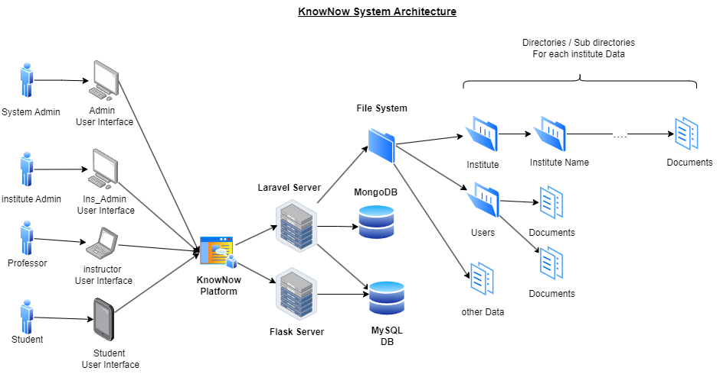
SYSTEM ARCH.
Notes:
Certificates Generation -> as motivational part for student
Compressing Videos -> to save server’s storage

Slide 19
TECHNOLOGIES & TOOLS
FRONTEND : Vanilla JS
AI:
Transformers & NLTK
01
04
BACKEND :
Laravel & FLASK
DESIGN :
Adobe PS , AI & Lucid.app
02
05
DATABASE :
MySQL & MongoDb
03

Slide 20

CONCLUSION

Slide 21
CONCLUSION
Our Platform is committed to simplifying the learning process for educators and learners.
Moving forward, our emphasis on flexibility and utility will guarantee that our platform remains user-friendly and adaptable to evolving educational trends.
We aim to make a platform that matches the quality of our education.
Notes:
في الاخر لو احنا مش مؤمنين باللي بنعمله مش هنعرف نقدمه بالشكل المناسب اتمني اننا نكون وصلنا فكرتنا بشكل واضح ونتمني اننا نعكس مستوي تعلمنا من خلال المنصة ديه

Slide 22
THANK YOU!

Slide 23
References
The Issue of Procrastination Among High School Students – The Spokesman
Helping Students Overcome Procrastination | National University (nu.edu)
Procrastination: Causes, Types, and How to Overcome It (verywellhealth.com)
https://e-student.org/best-study-methods/
Website Performance (similarweb.com)

